Slide 1
Association Rules

Slide 2
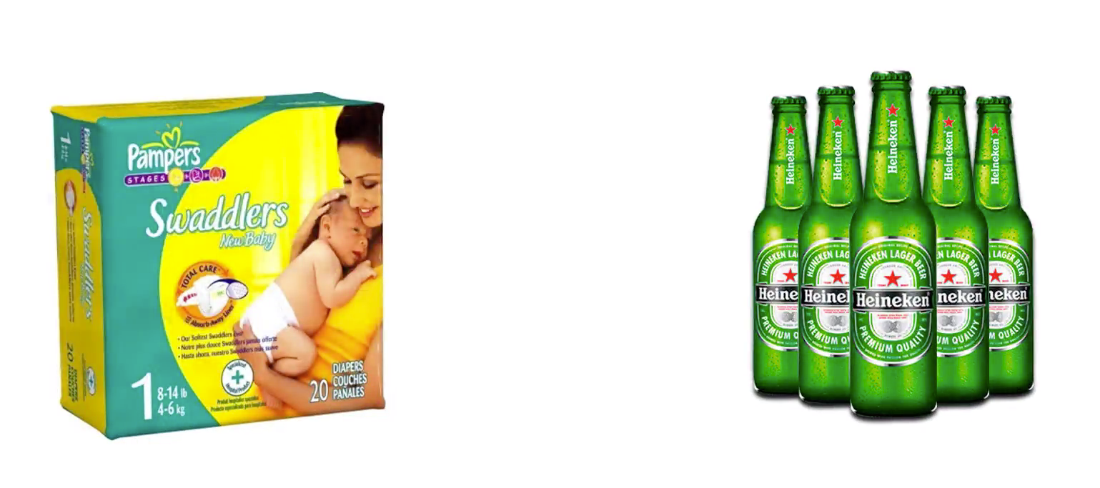
Association Rules

Slide 3
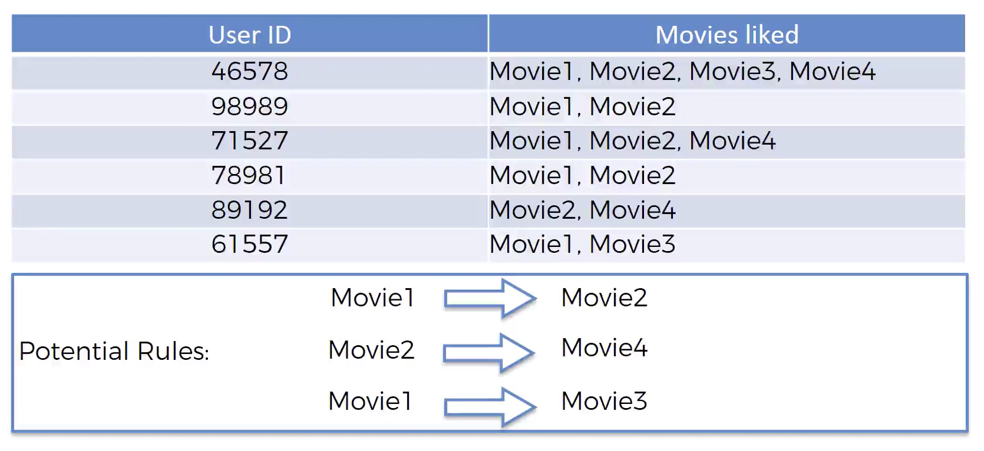
Movie Recommendation

Slide 4
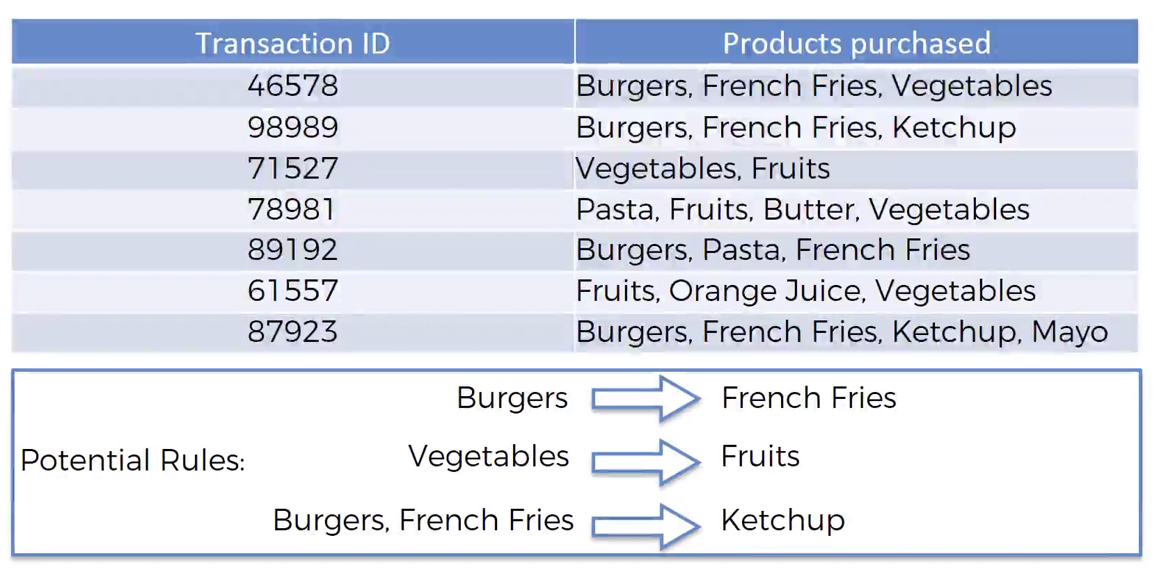
Market Basket Optimization

Slide 5
Apriori

Slide 6
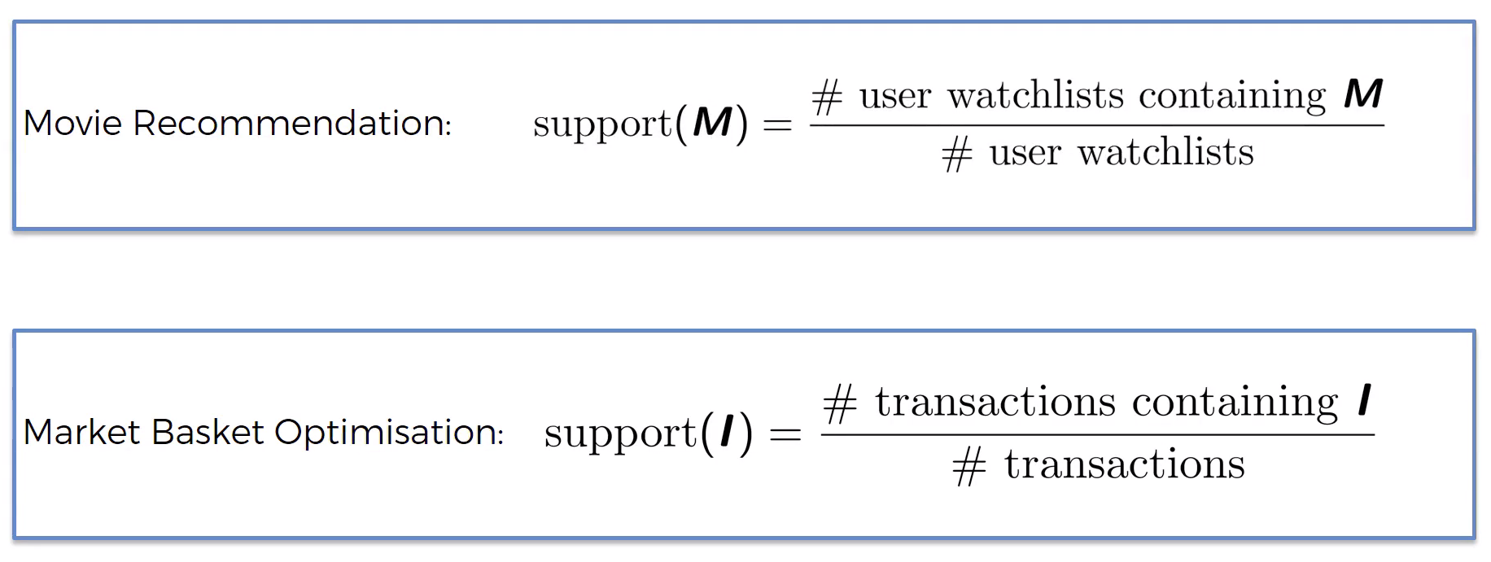
Apriori - Support

Slide 7
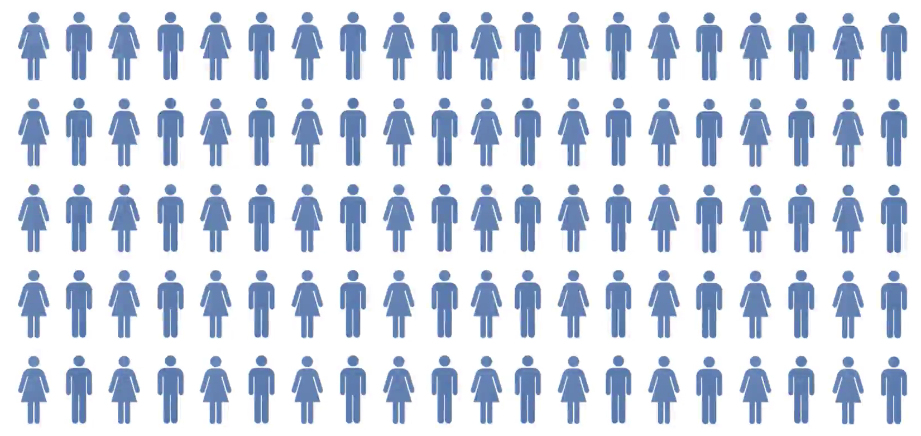
Apriori - Support

Slide 8
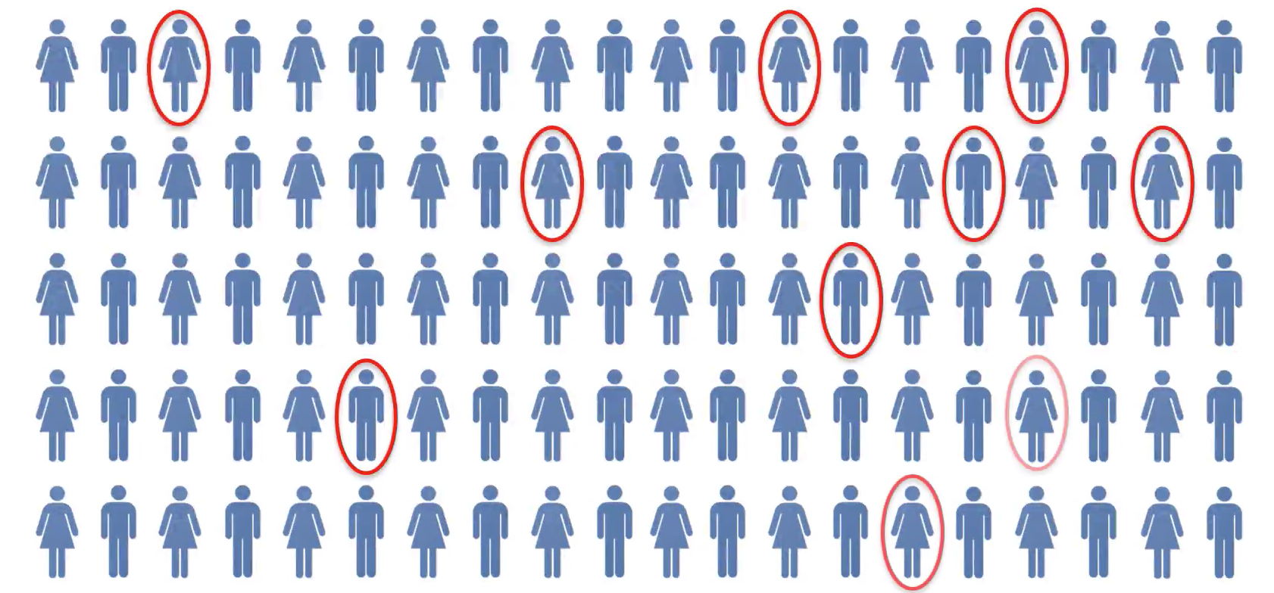
Apriori - Support
Support = 10/100
= 10%

Slide 9
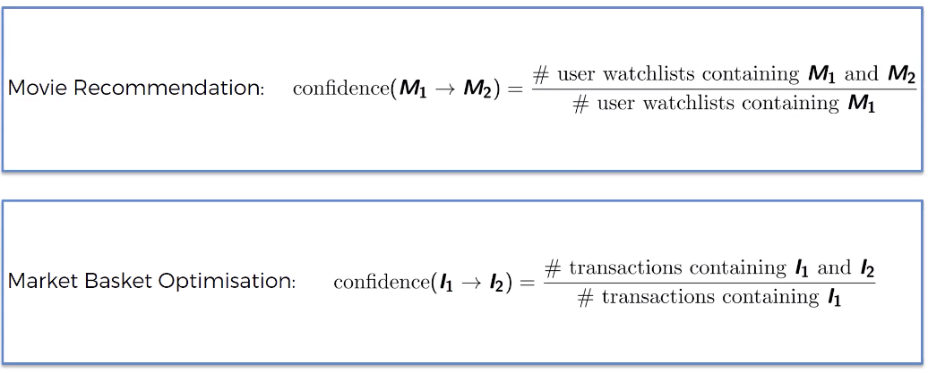
Apriori – Confidence

Slide 10
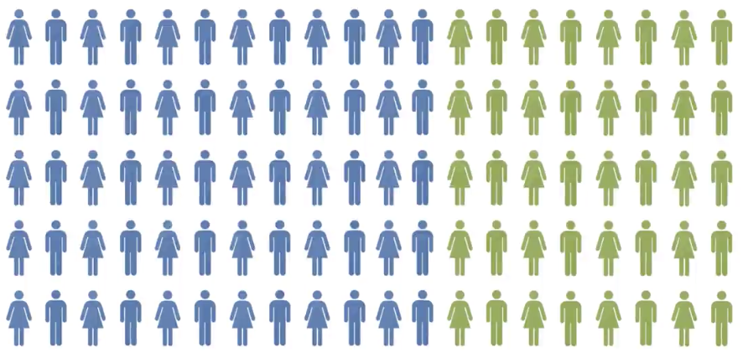
Apriori – Confidence

Slide 11
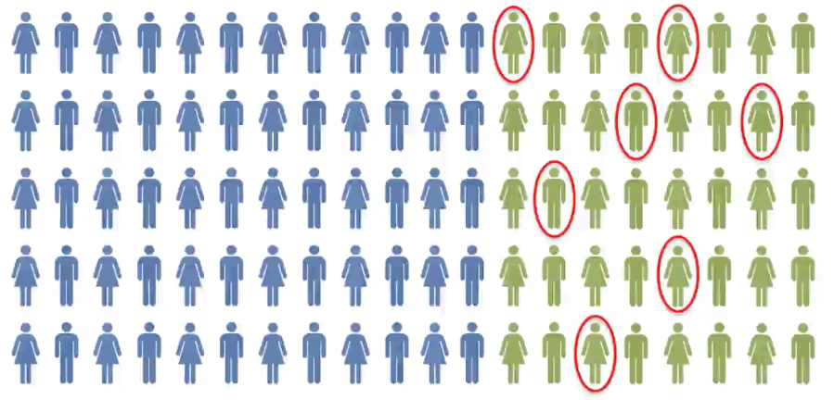
Apriori – Confidence
Confidence
= 7 / 40
= 17.5%

Slide 12
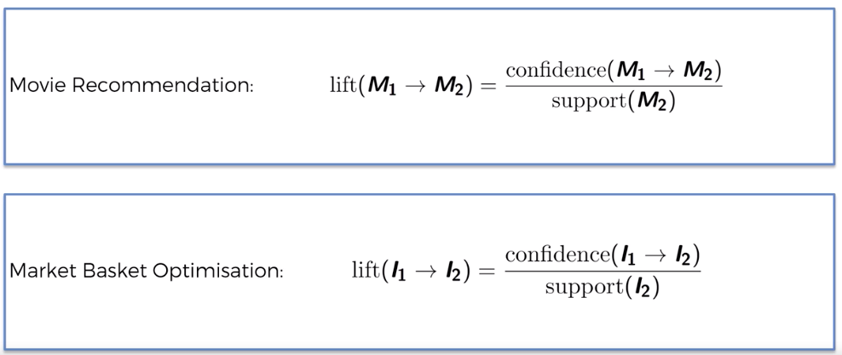
Apriori – Lift

Slide 13
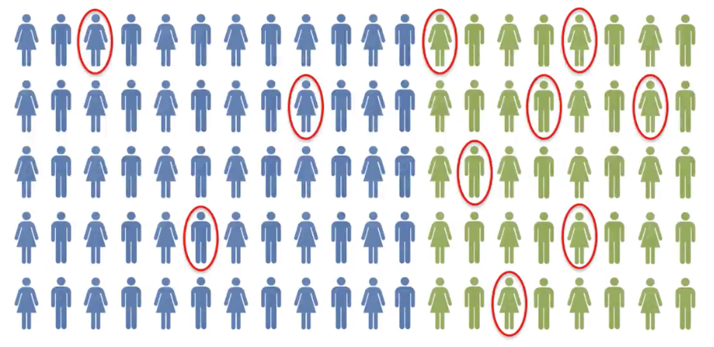
Apriori – Lift
Lift = 17.5% / 10%
= 1.75

Slide 14
Apriori – Algorithm
Set a minimum support and confidence
Take all the subsets in transactions having higher support than minimum support
Take all the rules of these subsets having higher confidence than minimum confidence
Sort the rules by decreasing lift

